Slide 1

THE HOTEL INDUSTRY
CORPORATE FINANCE
ASSIGNEMENT 1
GROUP E
ZAINA, YI, LORIS, SHASHANK, FELIX, BRUNO & ENZO

Slide 2
THE INDUSTRY
HOTELS
RENTALS
ACCOMODATION
MOTELS
HOSTELS
CAMPING
ETC…
FOOD AND BEVERAGES
RESTAURANTS
BARS
NIGHTCLUBS
CAFES
SERVICE
HOSTITALITY AND TOURISM
PUBS
ETC…
TOURISM
TRAVEL AGENCIES
TELECOMUNICATION
TOUR OPERATORS
FINANCIAL SERVICES
LEISURE CENTERS
TRANSPORTATION
AIRLINES
CRUISE LINES
CONSULTING
TAXI / VTC
BUSES
RAILWAY
ETC…
PUBLIC HEALTH
EVENTS
CONVENTIONS AND FAIRS
FESTIVALS
ETC…
ETC…
ETC…
Notes:
Hotel is in the Accomodation segement of the Travel and Tourism Market which is part of the Service Industry

Slide 3
US$624,71 bn
4%
10.2%
The Global Hotel Market Worth in 2018
Compounded Annual Growth Rate for 2015-2021
Contribution to the World’s GDP
Notes:
Source: The Global Hotel Report
CAGR of 4% is 2% higher than the global economy forecasted growth
10,2% is the second industry generating GDP after Financial Services (19.4%) BUT it contribute TWICE as MUCH to the global employment then FS
CAGR geometric progession ratio that provides a constant growth rate over a certain time period

Slide 4
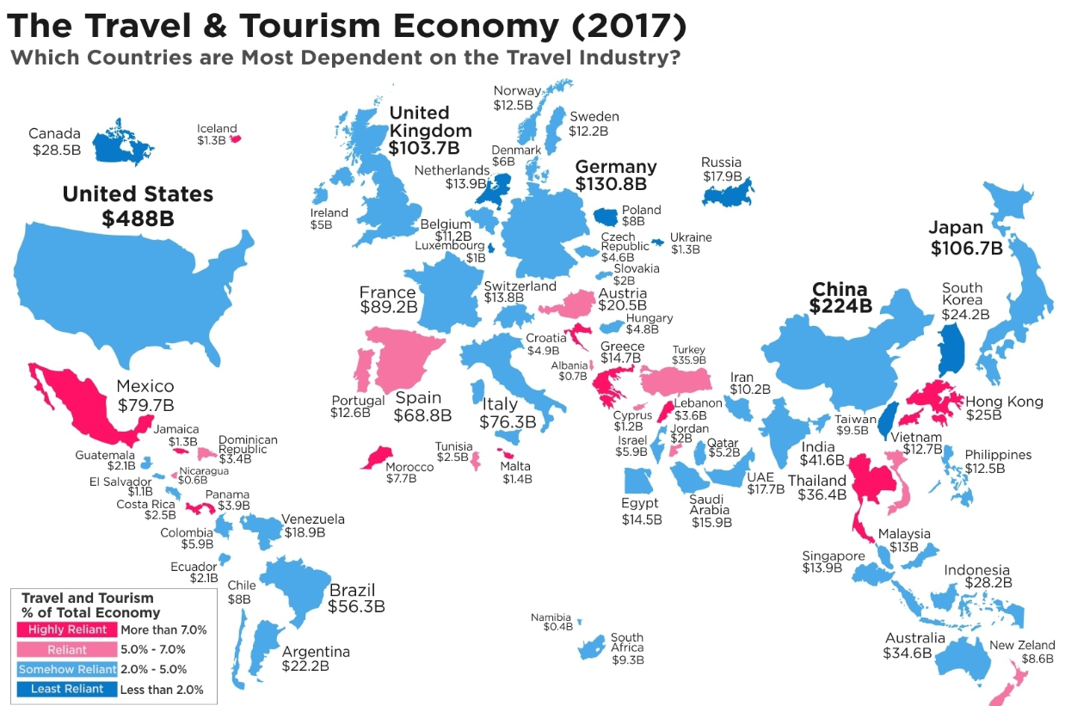
Notes:
Source: Travel & Tourism Competitiveness Report 2017.
The size translate the amount of T&T contribution to the local economy and the color the dependence of that country on the T&T (the % of the GDP represented by T&T)

Slide 5
HOTEL CATEGORIZATION
Ownership:
Independent
Signle Owner
Chain Hotels
Target Market:
Airport/Business/ Suite
Extended stay
S. Apartements
Resorts / Casino / Golf
B&B
Conference
Timeshare
Boutique/Ecotels
Service:
Luxury
Upper Upscale
Upscale
Upper Midscale
Midscale
Economy
Size:
Under 200
400 to 399
400 to 699
700 or over
Notes:
1. Size - Or number of rooms
Under 200 rooms
200 to 399 rooms
400 to 700 rooms
More than 700 rooms
The above categories enable hotels of similar size to compare operating procedures and statistical results.
2. Target Markets
Hotel targets many markets and can be classified according to the markets they attempt to attract their guests. The common type of markets includes business, airport, suites, residential, resort, timeshare, casino, convention and conference hotels.
Business Hotels: These hotels are the largest group of hotel types and they primarily cater to business travellers and usually located in downtown or business districts. Although Business hotels primarily serve business travellers, many tour groups, individual tourists and small conference groups find these hotels attractive. Guest amenities at business hotels may include complimentary newspapers, morning coffee, free local telephone calls, Breakfast etc.
Airport Hotels: These type of hotels typically target business clientele, airline passengers with overnight travel layovers or cancelled flights and airline crews or staff. Some hotels might give free transport between hotel and airport. Some Airport hotels also charge the guest by the hour instead of normal daily night charges.
Suite Hotels: These kind of hotels are the latest trend and the fastest growing segments of the hotel industry. Such hotels have a living room and a separate bedroom. Professionals such as accountants, lawyers, businessmen and executives find suite hotels particularly attractive as they can work and also entertain in an area beside the bedroom.
Extended Stay Hotels: Extended stay hotels are somewhat similar to the suite hotels, but usually offers kitchen amenities in the room. These kind of hotels are for long-stayers who want to stay more than a week and does not want to spend on hotel facilities.
Serviced Apartments: Serviced Apartment / Residential hotels provide long-term or permanent accommodation for Guest. Usually guest makes a lease agreement with the hotel for the minimum of one month up to a year. Rooms generally include living room, bedroom, kitchen, private balcony, washing machines, kitchen utensils etc. Unlike normal hotels Serviced apartment only provide weekly one housekeeping service.
Resort Hotels: Resort hotels are usually located in the mountains, on an island, or in some other exotic locations away from cities. These hotels have recreational facilities, scenery, golf, tennis, sailing, skiing and swimming. Resort hotels provide enjoyable and memorable guest experiences that encourage guest to repeat to the resort.
Bed and Breakfast / Homestays: These are houses with rooms converted into overnight facilities, this can size up to 1 to 10 guest rooms. They are also known as 'Home Stay's'. The owner of the B&B usually stay on the premises and is responsible for serving breakfast to the guest.
Timeshare / Vacation Rentals: Another new type or segment of the hospitality industry is the timeshare hotels. These are sometimes referred to as " Vacation-interval" hotels. Timeshare hotels are where the guests who purchase the ownership of accommodations for a specific period. These owners may also have the unit rented out by the management company that operates the hotel.
Casino Hotels: Hotels with gambling facilities are called Casino Hotels. Although the food and beverage operations in the casino are luxurious their functions are secondary to and supportive of casino operations.
Conference and Convention Centres: These type of hotels focus on meeting and conferences and overnight accommodation for meeting attendees. They also provide video conferencing facility, audiovisual equipment, business services, flexible seating arrangements, flipchart etc. These hotels mostly located outside the metropolitan areas and have facilities like golf, swimming pools, tennis courts, fitness centres, spas etc.
3. Levels Of service
World class service: These are also called luxury / Five Start hotels, they target top business executives, entertainment celebrities, high- ranking political figures, and wealthy clientele as their primary markets. They provide upscale restaurants and lounges, Valet, concierge services and also private dining facilities.
Mid-Range Service: Hotels offering mid-range or otherwise 3 to 4-star hotels service appeal the largest segment of the travelling public. This kind of hotels does not provide elaborate service and have a adequate staffing. They also provide uniformed service, food and beverage room service, in-room entertainment's and also Wi-Fi etc.
Budget / Limited Service: These hotels provide clean, comfortable, safe, inexpensive rooms and meet the basic need of guests. Budget hotels appeal primarily to budget-minded travellers who want a room with minimum services and amenities required for the comfortable stay, without unnecessary paying additional cost for costly services.
4. Ownership and Affiliations
Independent / Single Owner Hotels: They do not have identifiable ownership or management affiliation with other properties. Example of the same would be family owned and operated hotel that is not following any corporate policies or procedures.
Chain hotels: Hotels which are part of a hotel chain and these kinds of ownership usually imposes certain minimum standards, rules, policies and procedures to restrict affiliate activities. In general the more centralised the organisation the stronger the control over the individual property .

Slide 6
DRIVERS of
SUPPLY AND DEMAND
purchasing power of households
exchange rates
amount and type of competition
regulations
Government urban development
amount of substitute accomodation
seasonality
security
taxes
growth of the local market
type of destination
available workforce
technology
major events
industry trends
activities available
tastes and preferences
Notes:
Red for Supply
Bleu for Demand
And Black for both

Slide 7
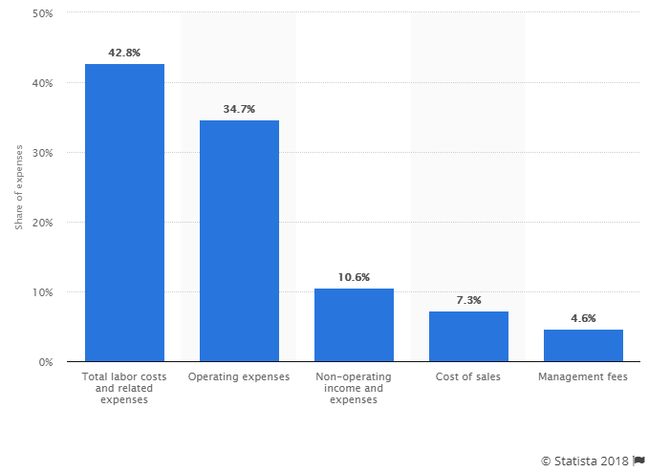
HOTEL COSTS BREAKDOWN
FACTORS DRIVING COSTS
Minimum wages & social charges
Cost of energy
Food price
Operational scheme (franchise, management contract, lease, owned etc…)
Amortization
Etc…
Notes:
Source Statista

Slide 8
YIELD MANAGEMENT
THE PRICING
CRITERIA FOR APPLICATION
Perishable inventory
Relatively fixed capacity
High fixed costs, low variable costs
Advance reservations
Time variable demand
Segmentable markets
PROBLEM COMPONENTS
Demand patterns for different rates
Overbooking policy
Demand elasticity
Information system
Lufthansa
Renfe
Arsenal FC
AirBnB
Uber
Selling the right room, to the right customer, at the right time for the right price
Notes:
Relatively fixed capacity. Since the focus of yield management is efficient allocation of shared fixed capacity, it is only appropriate for firms which cannot quickly adapt available capacity to available demand. For example, if all rooms in a hotel are occupied, another room cannot easily be added, although the customer may be accommodated in a sister hotel in a different part of the city. For airlines, if all seats on a flight are occupied, the plane cannot be enlarged, but it may be possible to put the passenger on a later flight. Essentially, capacity is fixed, although there may be some limited flexibility.
Ability to segment markets. In order for a yield management program to be effective, the firm must segment its market into different types of customers. For example, the airline industry distinguishes between time-sensitive and price sensitive customers by requiring a Saturday night stay for most discounted fares. Basically, the business must know which customers are most likely to use variously-priced classes of service, and must develop different marketing strategies for each market segment.
Perishable inventory. One of the key factors distinguishing service firms from manufacturing firms is that the inventory is perishable. In the case of capacity-constrained service firms, the problem is even more severe in that additional capacity cannot be obtained. Seats unsold on an airplane, rooms unsold in a hotel, or cars unrented at a rental car agency all represent spoiled or wasted inventory. If a firm can minimize its inventory spoilage, it will operate much more efficiently.
Product sold in advance. One of the capacity management tools that service businesses use is a reservation system in which units of inventory are sold in advance of actual use. Reservations systems provide the firm with some measure of security, in that they know that their capacity will be used in the future, but when the product is sold in advance, the manager is also faced with uncertainty. The manager must decide whether to accept an early reservation of a customer who wants low price, or wait and see if higher paying customers will appear. With a good yield management system, this type of situation can be addressed.
Fluctuating demand. Many service firms face highly erratic demand patterns, and managers must devise some method of dealing with this uncertainty. Yield management can be used to help temper some of the demand fluctuations by increasing utilization during slow demand times (by decreasing price), and by increasing revenue during times of high demand (by increasing price). If a manager knows when demand peaks and valleys will occur, he/she will be better able to plan for them.
Low marginal sales costs/high marginal capacity change costs. For a yield management system to be effective, marginal sales costs, the cost of selling an additional unit of inventory, must be low, but marginal capacity change costs should be high. For capacity-constrained firms, providing additional capacity is a very expensive proposition, but selling another unit of available capacity is relatively inexpensive
Demand patterns. Information on historical demand patterns for various rate classes must be available. Most yield management systems in commercial use are based strictly on historical demand patterns. Generally, in the airline industry, demand is assumed to follow a normal distribution (Belobaba (1987)). The probability distribution of demand in other industries has not yet been rigorously studied. In addition, information on the booking pattern for each rate class must be obtained in order to better understand the behavior of the different customers. Generally, bookings have been assumed to follow a random Poisson probability distribution (Beckman (1958), Thompson (1961), Taylor (1962)). Finally, the demands for different rate classes must be studied to determine the possibility of correlation among rate classes. By knowing the interaction between rate classes, a firm can better understand how many inventory units which could have been sold at a high price may be cannibalized by selling too many inventory units at a lower price. Several other assumptions often made include the forgetfulness property which states that the probability of cancellation is not dependent upon when the reservation was made, and that customers will freely upgrade or downgrade their class of service (Thompson (1961)). The latter hypothesis may be based on unrealistic price elasticity assumptions which will lead to inaccurate model results.
(2) Overbooking policies. Overbooking policies must also be assessed and include information on historical no-show rates and current policies on overbooking. The overbooking problem has been studied rather extensively (Rothstein (1971), Rothstein (1974), Schlifer and Vardi (1975), Ladany (1976), Ladany (1977), Hersh and Ladany (1978), Rothstein (1985), Alstrup et al. (1986)). Generally, cancellations are assumed to follow a binomial distribution, although this assumption has not been rigorously tested in all industries. The overbooking policy must be integrated with the yield management program or sales will be limited to an arbitrarily low level.
(3) Demand elasticities. The effect of price changes on demand must also be assessed. As mentioned above, yield management consists of both pricing and inventory management components. Although pricing has a direct impact on revenues, most firms cannot change price without taking the reactions of competitors into account. To fully use the potential of a yield management system, management must know the elasticity of demand for various rate classes and be able to make corresponding changes.
(4) Information system. The biggest problems facing a firm contemplating adoption of a yield management program are data availability and accuracy. A completely computerized management information system is not required; what matters is the type and accuracy of data collected. Without a good information system, the yield management system will be doomed to failure. For example, an airline which does not keep track of the number of discount seats sold for a particular flight can encounter a severe problem when all of the potential passengers arrive at the gate only to find an extremely-overbooked plane.

Slide 9

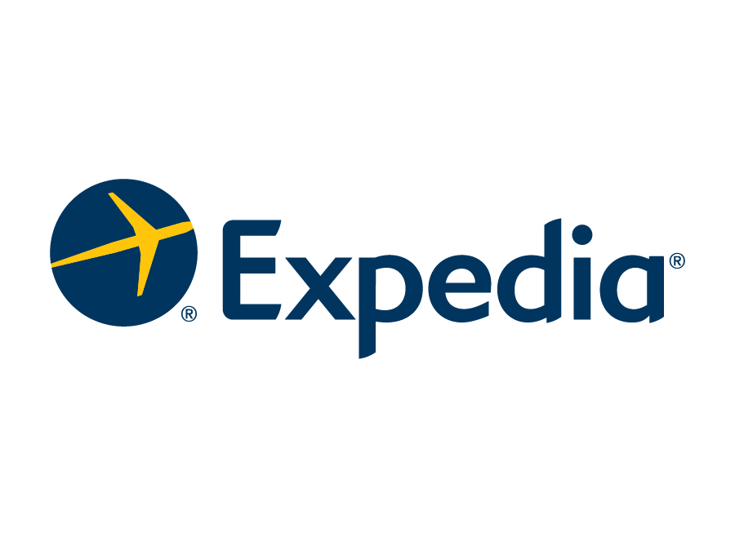


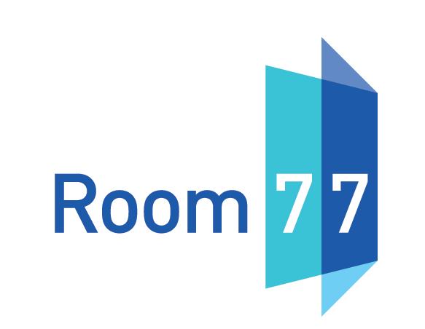
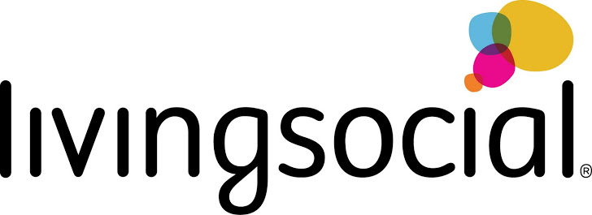
REVENUE MANAGEMENT TECHNIQUES
Online Travel Agencies (OTA)
Increase scope and overall revenue
Pricey, pressuring margins and increasing acquisition costs
Opaque Booking Channels (OBC)
Show price, stars and location but not the name of the hotel
Have decreasing growth over the past 4 years
Flash Sales Applications
Heavily discount rooms for same-day sales, fill-up last minut occupancy
Pressures down ADR, relaxes pressure to sell to OBC

Slide 10
INDUSTRY KPIs & Jargon
Competitive Set & STR Report
Capitalization Rate
MICE (meetings, incentives, conferences and events)
No-Shows, Walk-in & Overbooking
PMS (Property Management System)
GDS (Global Distribution System)
PiP (Property Improvement Plan)
REIT (Real Estate Investment Trust)
SMERF (social, military, educational, religious and fraternal)
Royalty Fees
Management Agreement
Franchise
ADR (average daily rate) = Room Revenue / Room Sold
Occupancy Rate (OR - %) = Room Sold / Room Available
RevPAR (Revenue Per Available Room) = ADR x OR
TRevPAR (T. Rev PAR) = Total Revenues / Room Sold
GOPPAR (Gross Operating Profit per Available Room
= GOP / Rooms Availanble

Slide 11
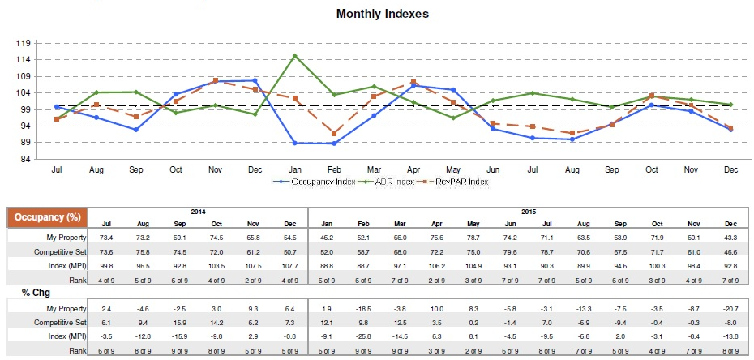
COMPETITIVE SET STR REPORTS

Slide 12
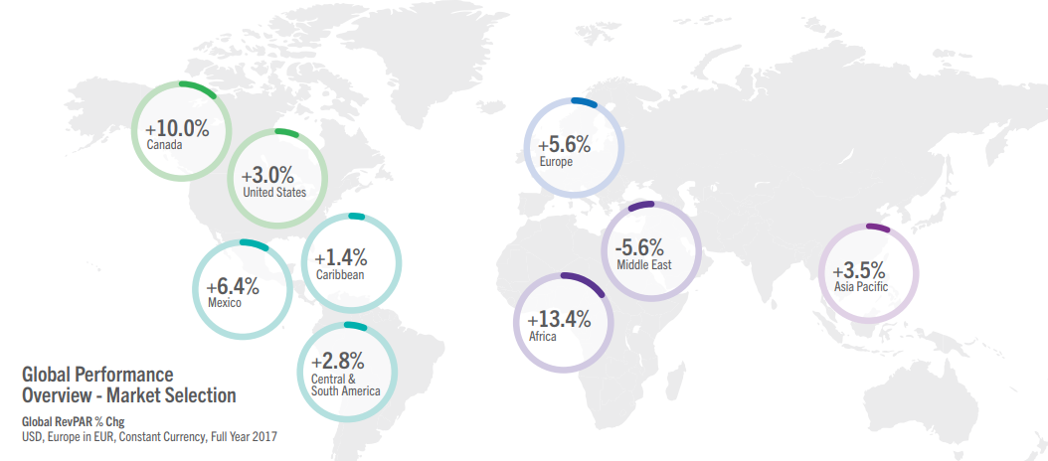
MARKETS GROWTH
Notes:
Based on Revenue Per Available Room. Booming in Africa and Canada.
Middle East Probably due to Terror and Unsecurity

Slide 13
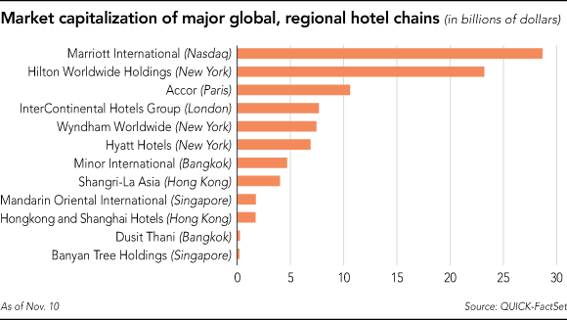
HOTEL GROUPS MARKET CAP
AIRBnB
US$ 31 bn
On March 9th

Slide 14
RISKS
😭
TASTE, PREFERENCES AND BEHAVIORS
Millenials (different spending habits, destinations …)
Responsible Tourism
Local Feeling
Personalized Experiences
DISRUPTIVE INNOVATION
Peer-to-peer renting (AirBnB, HomeAway, OneFineStay…)
Concierge Service (BnB Sitter, John Paul…)
Substitute Accomodation (Hostels, EcoLodge…)

Slide 15
FUTURE TRENDS AND STRATEGIES
ASSET LIGHT
STANDARDIZATION TO PERSONALIZATION
LOCAL EXPERIENCE
DIGITALIZATION
DIVERSIFICATION OF PORTFOLIO
Notes:
Asset Light: major hotel groups are selling their assets to Real estate companies in non strategic locations in order to refocus their asset holding in area of big growth
Standard to personalized: Up until now, majority of hotel brands were focusing on having the exact same standards accross the world (ie: A mercure room was the same in Japan, mexico and France), now people are looking for personalized room, with touches of local tastes and because of digital proximity for personalized contacts
Local experience: People want to feel the culture they visit and no more stay all day at the hotel
Digitalization: in selling rooms but also in-hotel experiences with chatbot, concierge etc… and also pre and post stay.
Major hotel groups are investing in disruptive technologies, ACCOR bought OneFineStay Mariott opened an Innovation Lab and purchased Starwood. More and more of interest is pointing toward BnB sitter companies in order to surf on the AirBnB trend.

Slide 16
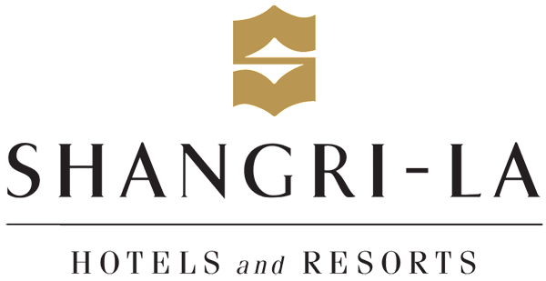
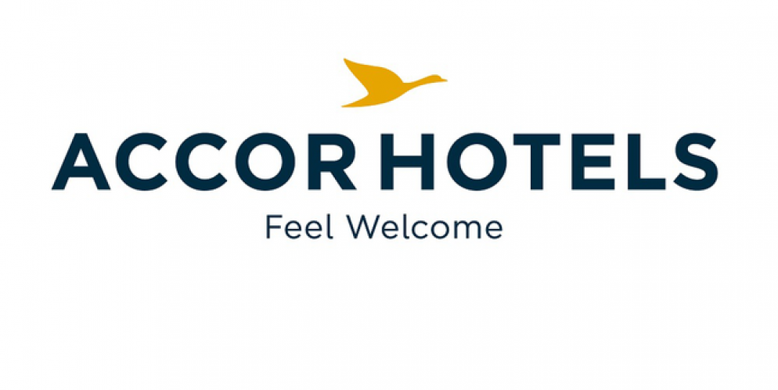
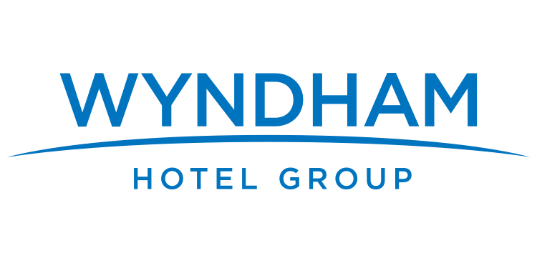

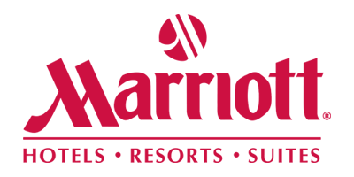

FINANCIALS
£ $ €

Slide 17
ANALYSIS 1: International Groups Multi Brand & Segments
Turnover : US $ 7.102 bn
EBIT : US $ 0.988 bn
Net Income : US $ 0.529 bn
Entreprise Value: US $ 17.271 bn
Number employees: 170 k
Turnover : US $ 22.894 bn
EBIT : US $ 2.518 bn
Net Income : US $ 1.372 bn
Entreprise Value: US $ 57.340 bn
Number employees: 177 k

Slide 18
Balance Sheet Income Statement
Tangible Fixed Asset
5 year Growth
- 76%
-16%
Tangible Fixed Asset as a % of TA
2013 to 2017
34.2% to 5.5%
22.7% to 7.5%
Intangible Fixed Asset as % of TA
2013 to 2017
13.9% to 31.5%
29.4% to 74.4%
Debt to Equity
2017
1.07
5.66
NC Liabilities as % of TA
2017
39.9%
60%
Quick Ratio
5 year Average
1.31
0.42
Profit Margin
5 year Average
5.1%
5.5%
Notes:
Tangible Asset decrease is a testymony of the asset light strategy
Marriott probably started earlier, because majority market is US and REIT are very present in the Real estate market
Intangible asset translate increase in purchasing of companies and patents etc… Mariott very high du to purchase of starwood
ACCOR purchased John Paul, OneFineStay and others in 2017 & 2016
D to E : how much debt to finance assets. Marriott was quite aggrssive when financing its growth with debt. Mainly due to the purchase of Starwood (ex #4)
Accor more conservative and riskless
Confirmed by the amount of NCL
The quick ratio shows whether the quick asset of the companies are enough to cover ST debt, ACCOR is well, Mariott probably due to purchases have high than normal Current liabilities.
Intreresting is the higher profit margin of mariott, because usually unstable earnings due to financing

Slide 19
ANALYSIS 2: International Groups Multi Brand & Single Segments
Turnover : US $ 2.191 bn
EBIT : US $ 0.195 bn
Net Income : US $ 0.144 bn
Entreprise Value: US $ 7.28 bn
Number employees: 30 k
Turnover : US $ 5.076 bn
EBIT : US $ 0.778 bn
Net Income : US $ 0.871 bn
Entreprise Value: US $ 17.648 bn
Number employees: 39.2 k
Notes:
Shangri La : 5 brands focused on Luxury
Hotel
Resorts
Traders Hotels
Kerry Hotels
Hotel Jen
Wyndham 20 brands focused on Upper Midscale to Budget

Slide 20
Balance Sheet Income Statement
Shareholders Equity as a % of TA
5 year Average
52%
10.8%
NC Liabilities as a % of TA
5 year Average
68.4%
35.3%
Debt to Equity Ratio
5 year Average
0.94
10.29
Contributed Capital as a % of TA
19.8% to 23.4%
0.01% to 0.01%
Tangible Fixed Asset
5 year Growth
3.4%
-30.5%
Intangible Fixed Asset
5 year Growth
532.2%
-11.7%
Profit Margin 5Y Average
1.2%
12.2%
Notes:
SHE NCL and D to E show the difference of financing and development strategy between the 2 company.
Shangri-La exclusive company, finance itself mainly from its stock and shareholders
Wyndham an American giant utilizes a more aggressive financing strategy in order to continue its massive scalling of lower end properties
Probably mainly from large banks and debt market
Tangible assets decreased by a third for the American translating the industry trend
Not for SL, because they already mainly invested in the most exclusive locations of their geographical presence
Intangible asset skyrocked for SL translating activity in the M&A. Probably coming from the Merger between Taj and their loyalty programs in 2016, the first alliance in the industry.
Finally, SL has shown quite a lot of volatility in its Income lastly translated by an abnormaly low Profit margin

Slide 21
ANALYSIS 3: International Single Brand & Single Segments
Turnover : US $ 739.9 m
EBIT : US $ 117.6 m
Net Income : US $ 147.8 m
Entreprise Value: US $ 3.065 bn
Number employees: 7.5 k
Turnover : US $ 61.4 m
EBIT : US $ 7.1 m
Net Income : US $ 4.7 m
Entreprise Value (est):
US $ 93.126 m
Number employees: 622
Notes:
ST christopher’s inn Value
Assuming a 5% average real estate cap rate accross their location
Value of company = Net Income / Cape Rate
= US $ 93.126 m

Slide 22
Balance Sheet Income Statement
Financial Leverage Ratio
5 year Average
0.2%
4.9%
Profit Margin
2017
20%
7.6%
Fixed Asset Turnover
5 year Average
0.14
1.08
Quick Ratio
5 year Average
1.46
0.38
Tangible Fixed Asset
5 year Growth
18.2%
-33.9%
Operating Revenue
5 year Growth
-17.0%
50.8%
EBIT
5 year Growth
-60.6%
1,104.9%
Notes:
FLR of peninsula is close to zero meaning that they generate merely as much return as they pay interests on the fund they borrow, which isn’t fantastic. This is explained by the incredibly high amount of SHE funds used by the company. This could translate a strong tie between investors and management board in an optic to generate more return to share holdrers
On the other hand St Christophers borrow more effectively through a well balance mix of SHE LTD and STD
Profit Margin side Penninsula is much more efficient, due to luxury vs budget discripancy
Fixed Asset Turnover is discussable indicator when comparing two companies so on the opposite. Peninsula proves to have very high fixed asset levels hence appearing less efficient when generating revenues from them.
ST Christopher although they also focus on fairly central locations they utilize they properties in a more efficient way. Probably because they make more usage of each Sq. feets
Quick Ratio: Penninsula is confortable, St Christopher inn due to their scalling and financing strategy recently are low.
The asset light strategy doesn’t reflect in Peninsula because they only have exclusive central location in dynamic places
We can see it for the hostel brand
Appart from the healtier indicator from peninsula, ST christopher Inn are experiencing better top and bottom line growth. On the opposite of Peninsula which in addtion of seeing its revenues decrease they did not manage to decrease their costs accordingly to remain profitable.

Slide 23
CONCLUSION!!
Any questions?
Notes:
What is stricking is that Luxury Brand tend to have similar financing strategy to one another, with high Equity financing.
Economy and Hostels as well, focusing on a more risky financing.
It is also interesting to see that companies with the most sexy ratios are not always the ones performing the better bottom-line wise.
Finally, it was interesting to prove both the current industry trends with the financial statement, especially with the decrease in Tangible Fixed Asset corresponding to the Asset Light strategy, but also with the increase of Intangible Assets translating an increase of M&A activities.

